Slide 1
PROXY SERVERS

Slide 2
What is a Proxy Server?
A proxy server is a server on a network which services the requests of its clients by forwarding requests to other servers.
A client connects to the proxy server, requesting some service, such as a file, connection, web page, or other resource, available from a different server.
The proxy server provides the resource by connecting to the specified server or to another proxy server and, eventually, requesting the service on behalf of the client.

Slide 3
There Are Many Kinds of Proxy Servers
We're concerned here with the following:
Anonymous proxy server
  An anonymous proxy server (sometimes called a web proxy) generally attempts to provide a certain degree of anonymous web surfing.
  These can easily be overridden by site administrators, and thus rendered useless in some cases.

Slide 4
Hostile proxy server
  Proxies can be installed by online criminals, in order to eavesdrop upon the dataflow between the client machine and the web.
  All accessed pages, as well as all forms submitted, can be captured and analyzed by the proxy operator.
  For this reason, passwords to online services should be changed if an unauthorized proxy is detected.

Slide 5
Transparent proxy server
A transparent proxy is a proxy that does not modify the request or response beyond what is required for proxy authentication and identification.
Some providers of proxy server listings specify additional modifying words such as high anonymous proxy server or elite anonymous proxy server.
There is are clear definitions for these.

Slide 6
Some of the Reasons for Using a Proxy
It helps provide a way to hide your identity from the sites which can see your personal information.
It can provide you greater flexibility to control your network.
It can give access to sites which are blocked in your area.
Some times it increases the browsing speed by storing frequently used pages in cache.
Since an identity can be hid, a cracker can enter sites without revealing who they are.

Slide 7
Where are Some of the Proxy Servers?
There are many lists available:
http://www.proxy4free.com/page1.html
http://samair.ru/proxy/
Tor is both a network of proxy servers and software that allow access to the network which is run by volunteers.
  The free software for accessing Tor can be found at http://www.torproject.org/index.html.en
I do not guarantee that these are secure.

Slide 8
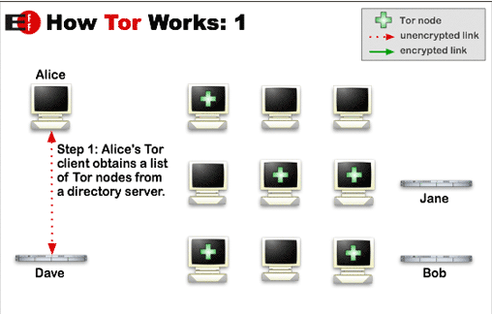
How Tor Works
Tor helps to reduce the risks of traffic analysis by distributing transactions over several places on the Internet, so no single point can link source to destination.
http://www.torproject.org/overview.html.en

Slide 9
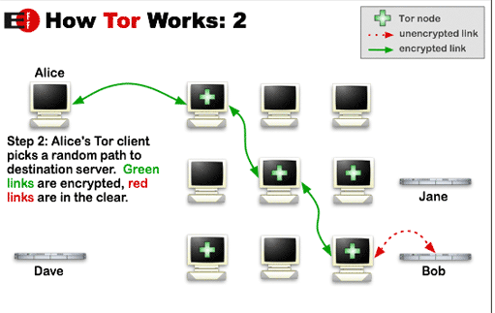
The user's software or client incrementally builds a circuit of individually negotiated encrypted connections through relays on the network.
The circuit is extended one hop at a time.
Each relay along the way knows only which relay gave it data and which relay it is giving data to.
No individual relay ever knows the complete path that a data packet has taken.

Slide 10
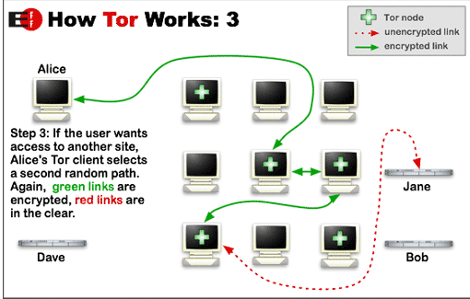
Once a circuit has been established, data can be exchanged and some software applications can be deployed over the Tor network.
Each relay sees only one hop in the circuit.
For efficiency, the Tor software uses the same circuit for connections that happen within the same ten minutes or so.
Later requests are given a new circuit, to prevent the linking of earlier actions to the new ones.

Slide 11
Risks With Some Proxy Servers
A malicious proxy server can record everything sent to it: including unencrypted logins and passwords.
By chaining proxies which do not reveal data about the original requester, it is possible to obfuscate activities from the eyes of the user's destination.
  However, then more traces will be left on the intermediate hops, which could be used to trace the user's activities.

Slide 12
Risks With Some Proxy Servers
If the policies and administrators of these other proxies are unknown, the user may fall victim to a false sense of security just because those details are out of sight and mind.
Be wary when using proxy servers, and only use proxy servers of known integrity.
If there is no choice but to use unknown proxy servers, do not pass any private information (unless it is properly encrypted) through the proxy.

Slide 13
Risks With Some Proxy Servers
In what is more of an inconvenience than a risk, proxy users may find themselves being blocked from certain Web sites, as numerous forums and Web sites block IP addresses from proxies known to have spammed or trolled the site.
There is still another problem to overcome when you wish to make an anonymous connection.
Your browser broadcasts a lot of information about you.

Slide 14
IP Addresses
An IP address (or Internet Protocol address) is a unique address that certain electronic devices use in order to identify and communicate with each other on a computer network utilizing the Internet Protocol standard (IP)- i.e., a computer address.
Any participating network devices such as routers, switches, computers, infrastructure servers, printers, Internet fax machines, and some telephones—can have its own address that is unique within the scope of the specific network.
Some IP addresses are intended to be unique within the scope of the global Internet, while others need to be unique only within a local scope.

Slide 15
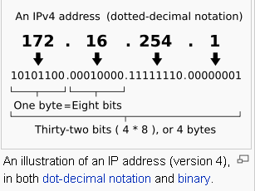
Format of an IP Address
The Internet Protocol (IP) has two versions currently in use.
Each version has its own format.
Because of its prevalence, "IP address" typically refers to those defined by IPv4, and this is the only one we'll consider.
http://en.wikipedia.org/wiki/IP_address

Slide 16
Obtaining an IP Address
On the public Internet, IP addresses are managed and created by the Internet Assigned Numbers Authority (IANA).
The IANA generally allocates super-blocks to Regional Internet Registries, who in turn allocate smaller blocks to Internet service providers and enterprises.
A system administrator, after obtaining the first two numbers of an IP address, can allocate the other two numbers for their private internets or intranets.

Slide 17
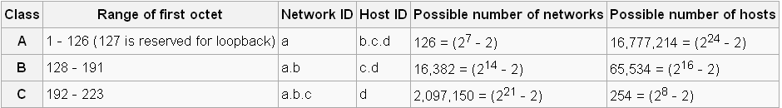
The IP Address Provides Some Information About the Possible Network Size
Currently, three classes of networks are used.
If a.b.c.d is the IP address, the chart below shows the relationship between the address and the possible size of a network.
Note: cs.hiram.edu is 206.57.41.44
home.hiram.edu is 143.206.107.71
http://en.wikipedia.org/wiki/IP_address

Slide 18
Unfortunately, the IP Address Provides More Than the Network Size
Many websites and most hackers use IP addresses to monitor your personal business
If your IP address is known, there is a lot of information immediately available about your computer configuration
Your home address and other personal information about you can be retrieved once your IP address is known

Slide 19
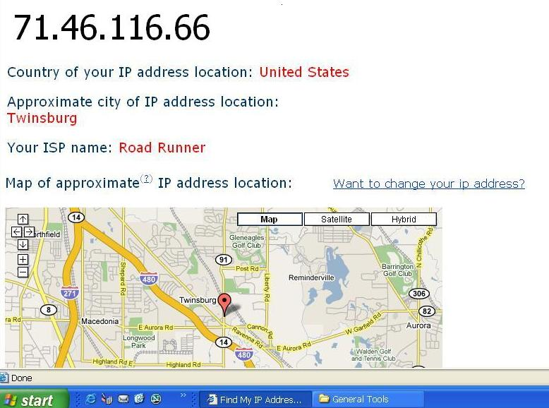
Before IP Address Is Hidden

Slide 20
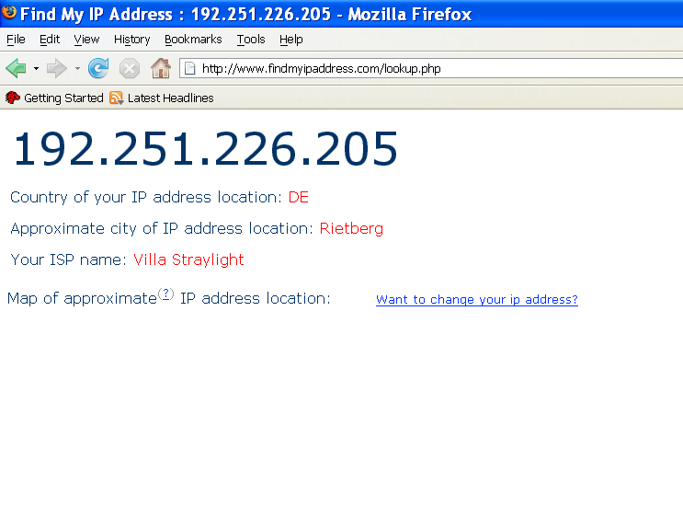
After Using Proxy Servers

Slide 21
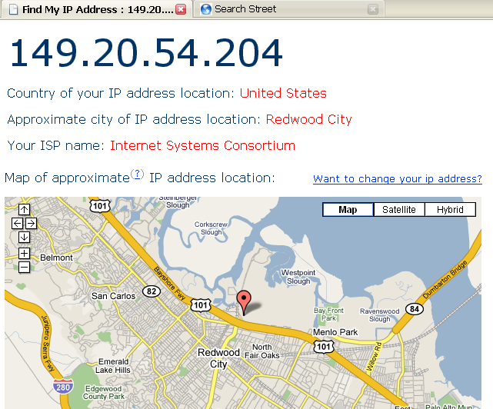
Another Session With Proxy Servers

Slide 22
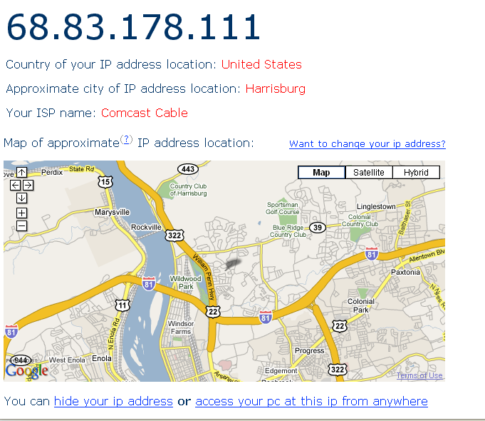
And, One More

Slide 23
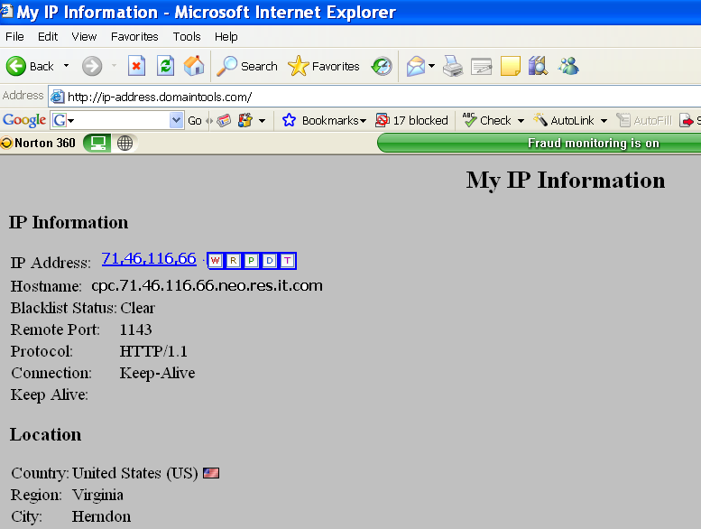
This Website Shows Even More for the IP Address

Slide 24
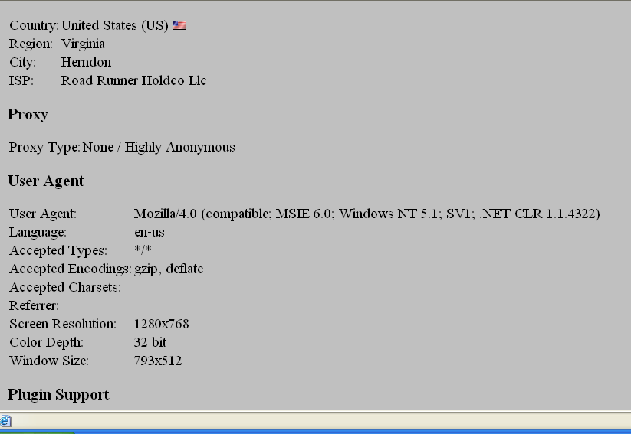
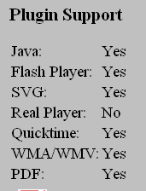

Slide 25
What is the Concern About Knowing This Information?

Slide 26
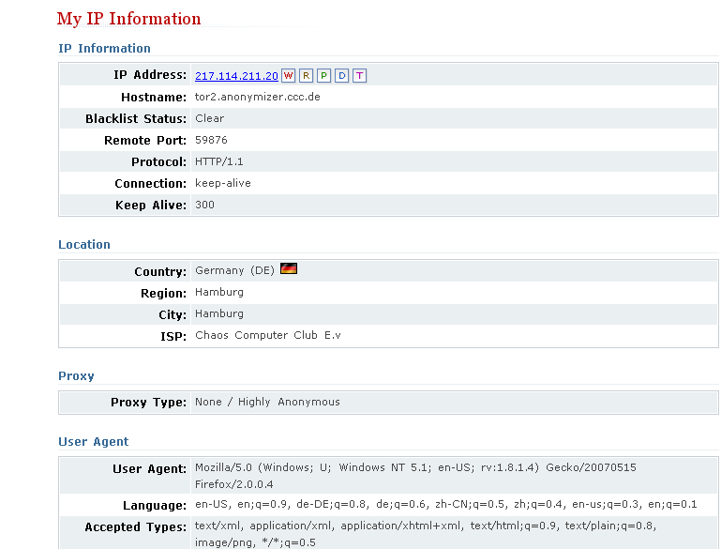
Using the Tor Network

Slide 27
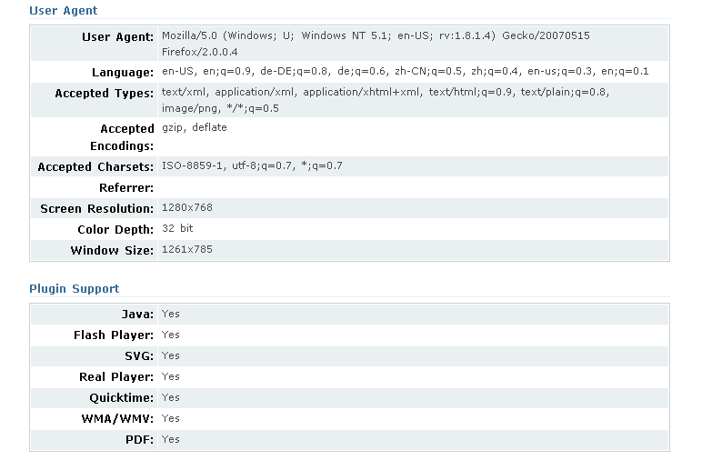

Slide 28
How Can You Net Surf Somewhat Anonymously?
Download software such as the Tor software (free) and use that network of proxies.
  Torbutton is a Firefox plugin that allows you to access the Tor network seamlessly.
  http://www.torproject.org/download.html.en
Change your IP address when you surf.
  There are many free and low cost services available for doing this.
  (free) http://www.computerhope.com/issues/ch000784.htm
  (low cost - changes IP and automatically uses Tor)- $29.95 http://www.hide-my-ip-address.com/hideip/?pu=false&srec=true

Slide 29
There Are Many Web Sites That Will Check Your IP Address
http://ip-address.domaintools.com/
http://www.findmyipaddress.com/lookup.php
http://www.findmyip.com/
http://www.hide-my-ip.com/
and many others exist!
Note: You should ALWAYS hide your IP address and use proxies if you decide to cruise hacker sites!!!

Slide 30
Pitfalls Still Exist When Using Proxy Networks Like Tor
Tor only protects Internet applications that are configured to send their traffic through Tor — it doesn't magically anonymize all your traffic just because you install it.
Browser plugins such as Java, Flash, ActiveX, RealPlayer, Quicktime, Adobe's PDF plugin, and others can be manipulated into revealing your IP address.
You should probably uninstall your plugins (go to "about:plugins" to see what is installed), or investigate QuickJava, FlashBlock, and NoScript if you really need them.

Slide 31
Pitfalls
Consider removing extensions that look up more information about the websites you select (like Google toolbar), as they may bypass Tor and/or broadcast sensitive information.
Some people use two browsers (one for Tor, one for unsafe browsing).
Beware of cookies: if you ever browse without Tor and Privoxy and a site gives you a cookie, that cookie could identify you even when you start using Tor again.
You should clear your cookies frequently. CookieCuller can help protect any cookies you do not want to lose.

Slide 32
Pitfalls
Tor anonymizes the origin of your traffic, and it encrypts everything inside the Tor network, but it can't encrypt your traffic between the Tor network and its final destination.
If you are communicating sensitive information, you should use as much care as you would on the normal scary Internet — use HTTPS or other end-to-end encryption and authentication.
While Tor blocks attackers on your local network from discovering or influencing your destination, it opens new risks: malicious or misconfigured Tor exit nodes can send you the wrong page, or even send you embedded Java applets disguised as domains you trust.

